Slide 1
6 symbols’ Correlation matrix with run1 run2 run3 run4 run5 run6

Slide 2
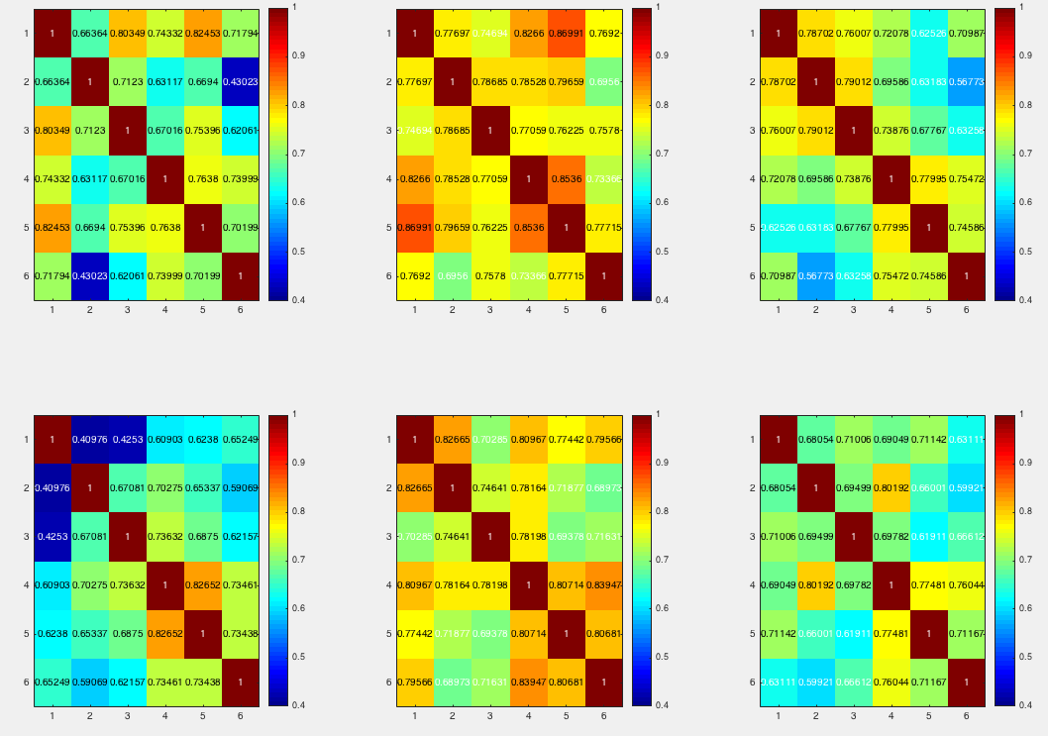
Irene1_Correlation_matrix_byruns_18parameter
mask1

Slide 3
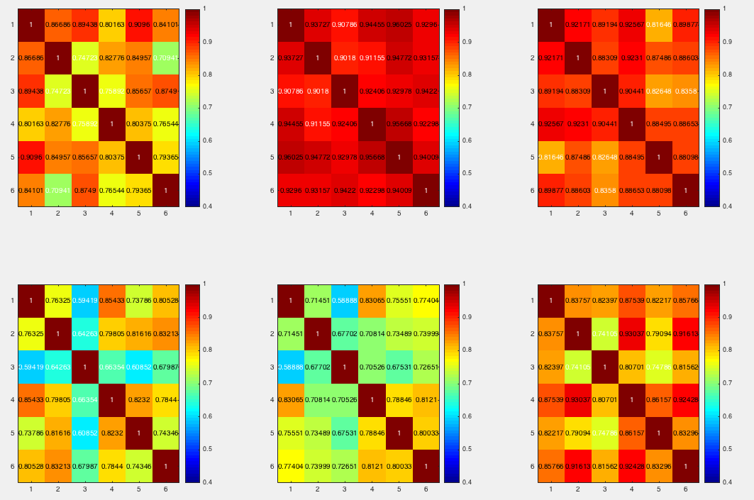
Irene1_Correlation_matrix_byruns_18parameter
mask2

Slide 4
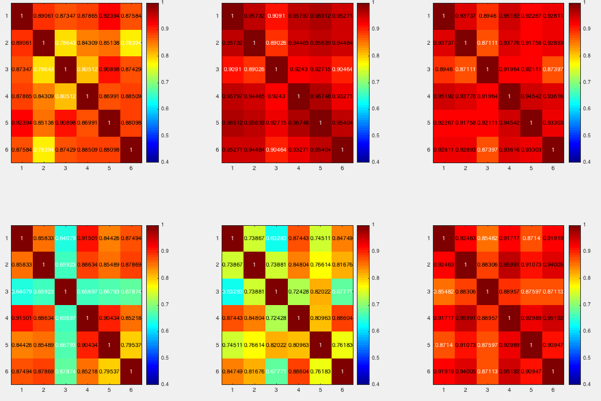
Irene1_Correlation_matrix_byruns_18parameter
mask3

Slide 5
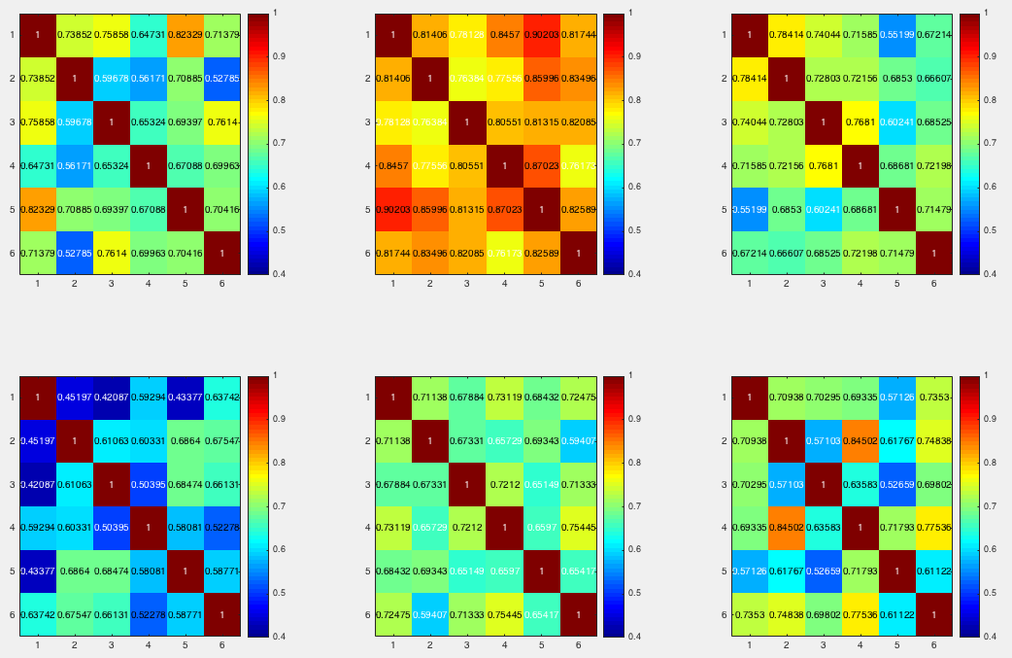
Irene1_Correlation_matrix_byruns_18parameter
mask4

Slide 6
Irene1_Correlation_matrix_byruns_18parameter
mask5

Slide 7
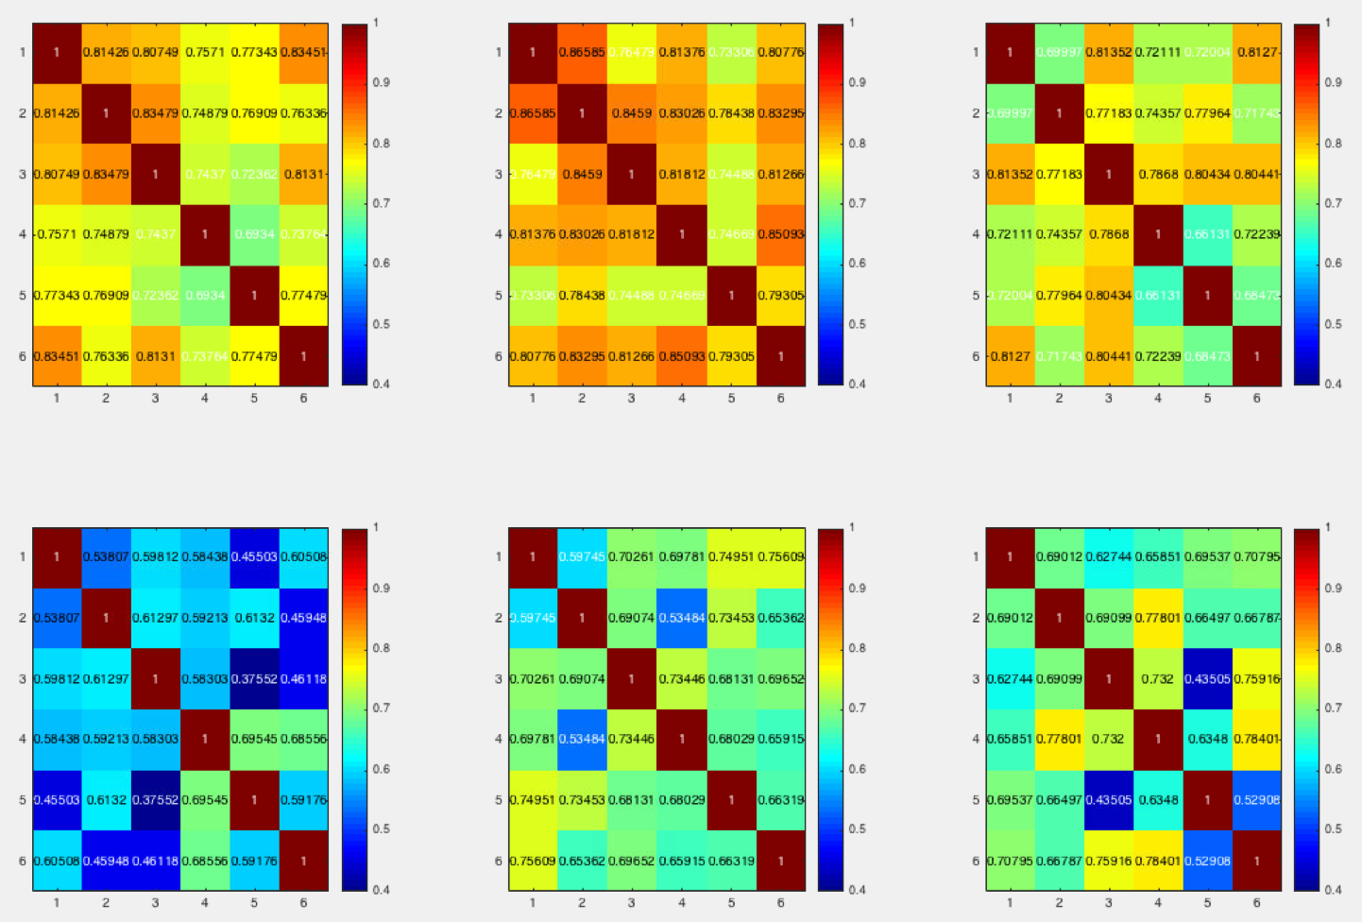
luo_Correlation_matrix_byruns_18parameter
mask1

Slide 8
luo_Correlation_matrix_byruns_18parameter
mask2

Slide 9
luo_Correlation_matrix_byruns_18parameter
mask3

Slide 10
luo_Correlation_matrix_byruns_18parameter
mask4

Slide 11
luo_Correlation_matrix_byruns_18parameter
mask5

Slide 12
irene2_Correlation_matrix_byruns_18parameter
mask1

Slide 13
irene2_Correlation_matrix_byruns_18parameter
mask2

Slide 14
irene2_Correlation_matrix_byruns_18parameter
mask3

Slide 15
irene2_Correlation_matrix_byruns_18parameter
mask4

Slide 16
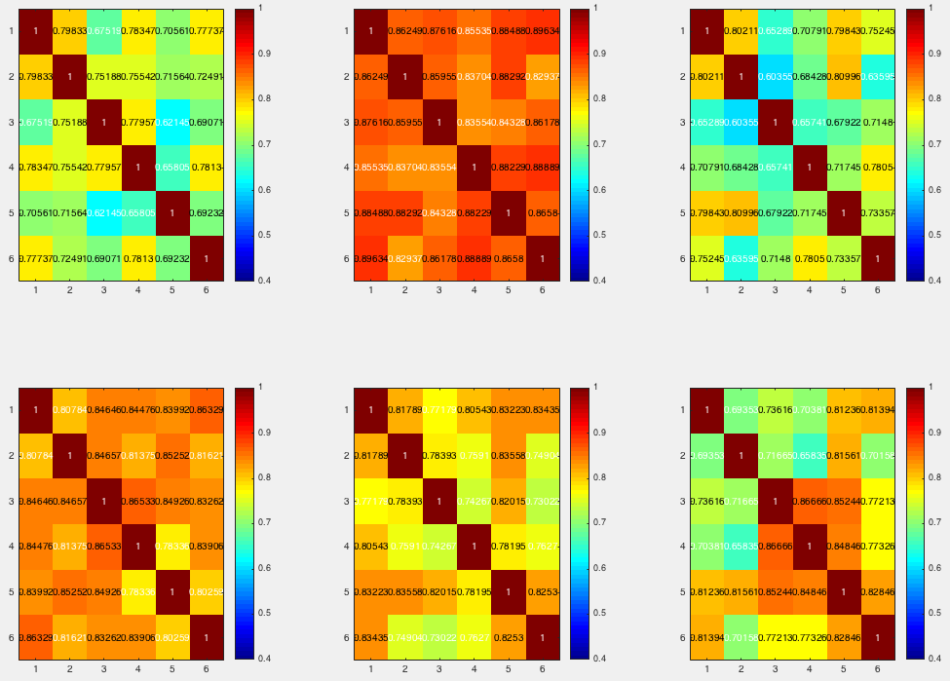
irene2_Correlation_matrix_byruns_18parameter
mask5

Slide 17
angela_Correlation_matrix_byruns_18parameter
mask1

Slide 18
angela_Correlation_matrix_byruns_18parameter
mask2

Slide 19
angela_Correlation_matrix_byruns_18parameter
mask3

Slide 20
angela_Correlation_matrix_byruns_18parameter
mask4

Slide 21
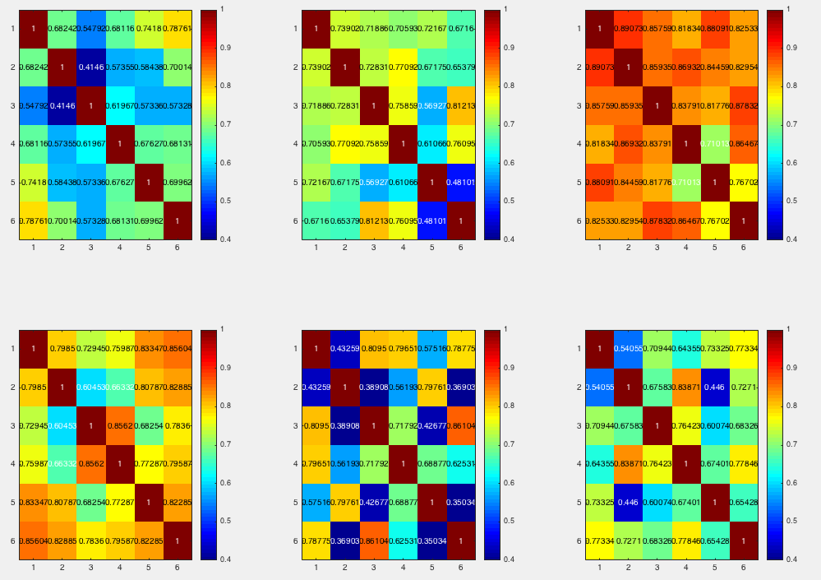
angela_Correlation_matrix_byruns_18parameter
mask5

